Slide 1
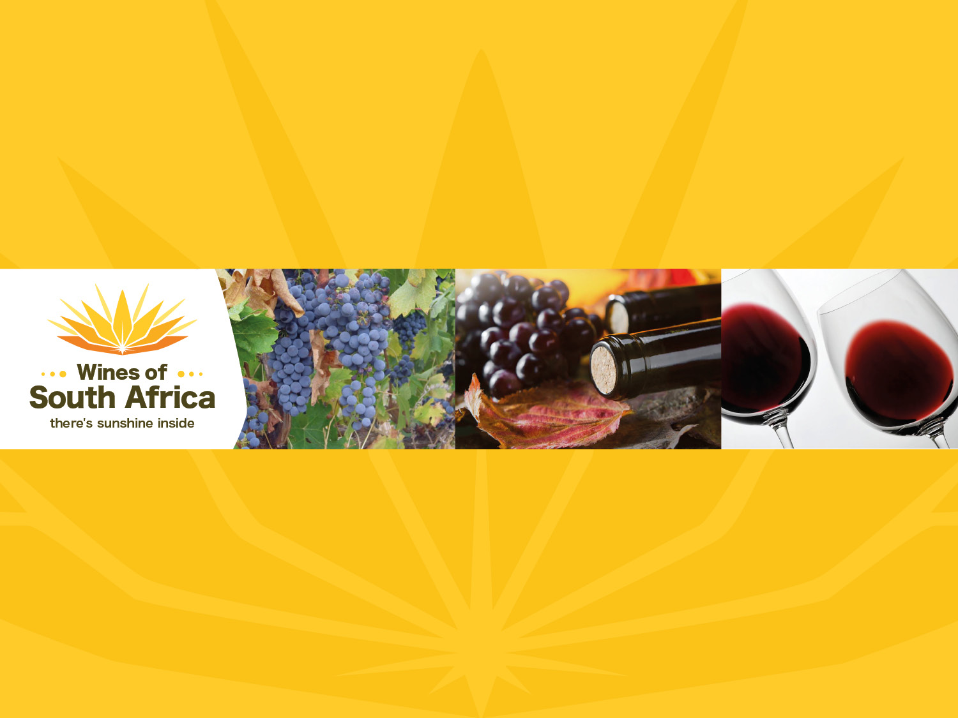
CABERNET SAUVIGNON

Slide 2
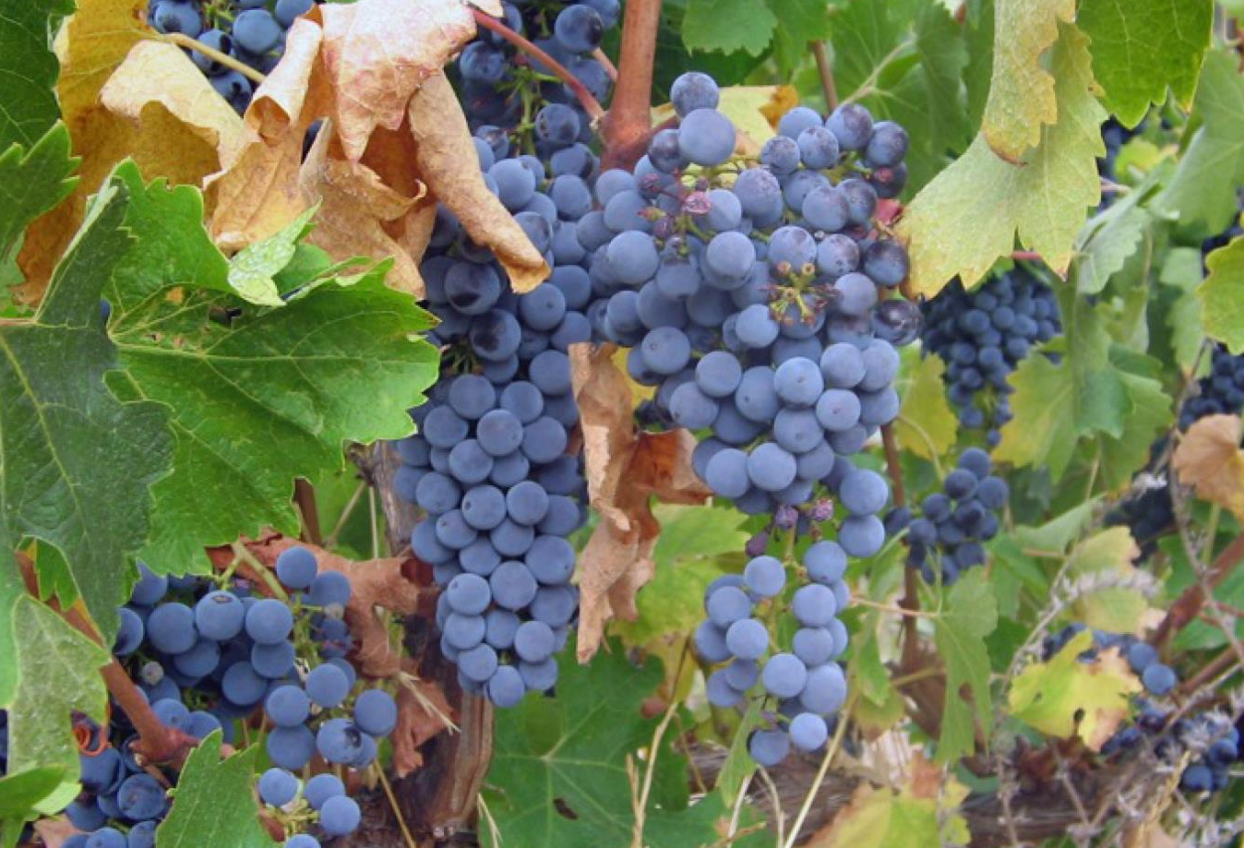
Notes:
Cabernet Sauvignon originated from a spontaneous cross between Cabernet Franc and Sauvignon Blanc, a fact that was only established in 1997, even though this noble variety has been cultivated in France for centuries.

Slide 3
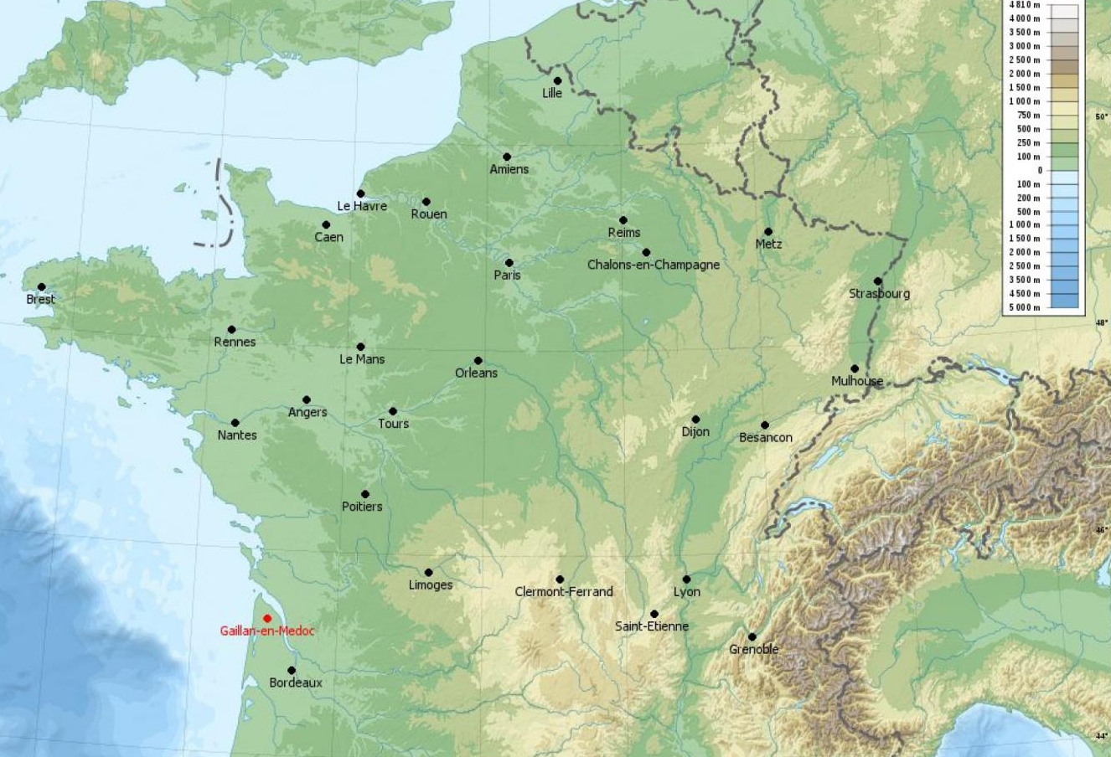
Notes:
In Bordeaux, Cabernet is the principle component in the famous wines of the Médoc.

Slide 4
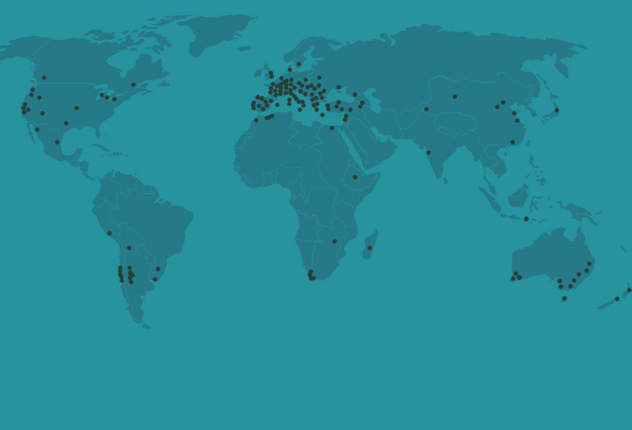
Notes:
Cabernet Sauvignon is now found all over the world, including in South Africa.

Slide 5
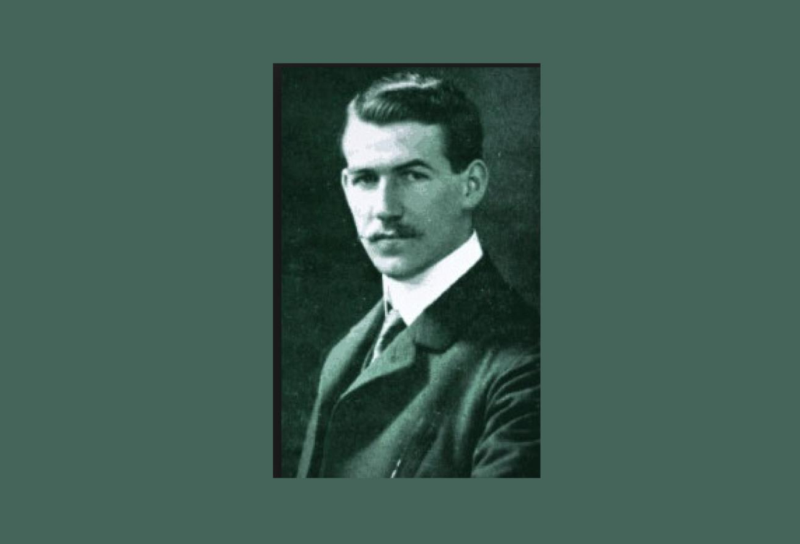
Notes:
It is not clear exactly when Cabernet Sauvignon was first planted in South Africa but it had already been recommended as a suitable variety by Professor Abraham Perold around 1920.

Slide 6
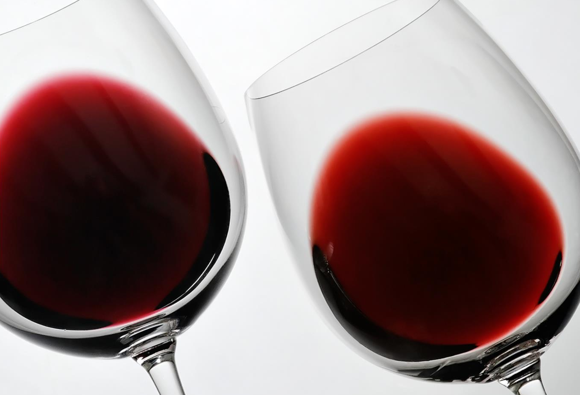
Notes:
Cabernet Sauvignon has become an increasingly significant variety in the Cape, where it produces red wines with excellent colour and good tannins that develop well with age into spicy, full complex wines.

Slide 7
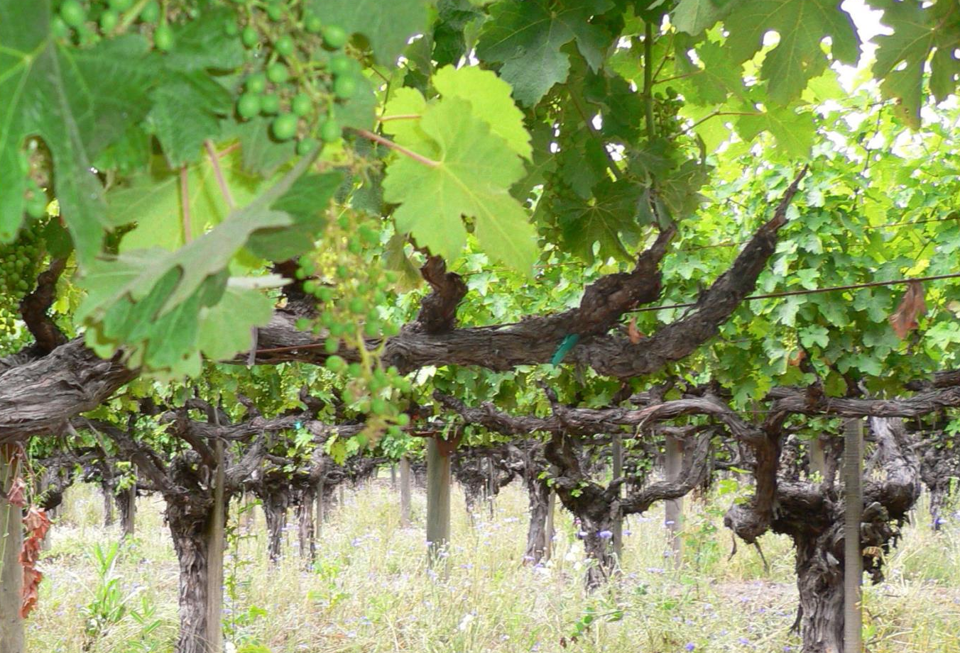
Notes:
Currently Cabernet Sauvignon is the most planted red-wine variety in South Africa, with total plantings at the end of 2025 accounting for 8 601 ha (9.9% of the national vineyard).

Slide 8
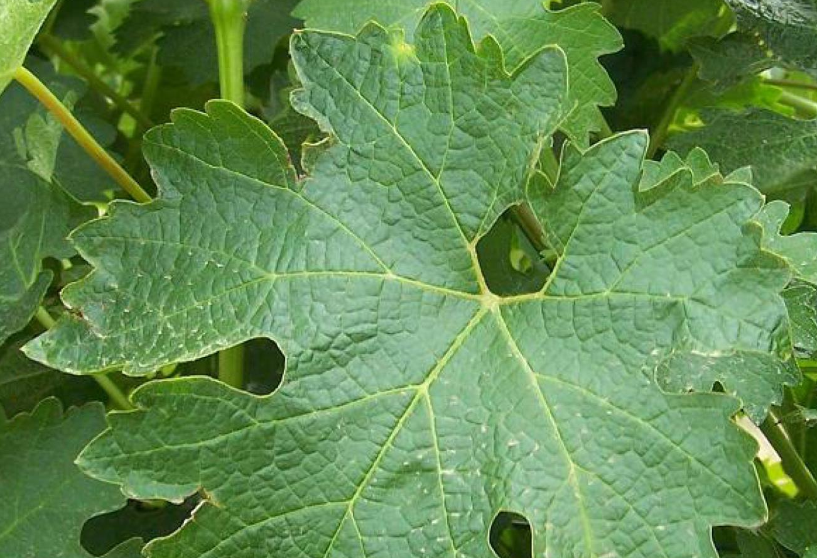
Notes:
Cabernet Sauvignon accounts for almost a quarter of the hectarage planted to red-wine varieties. The reason for its popularity is due to its adaptability, as it retains a recognisable character even when planted in less suitable locations.

Slide 9

Notes:
This noble grape variety is grown in almost all the regions of the Cape but most extensively in Stellenbosch and Paarl, followed by the Swartland and Robertson.

Slide 10
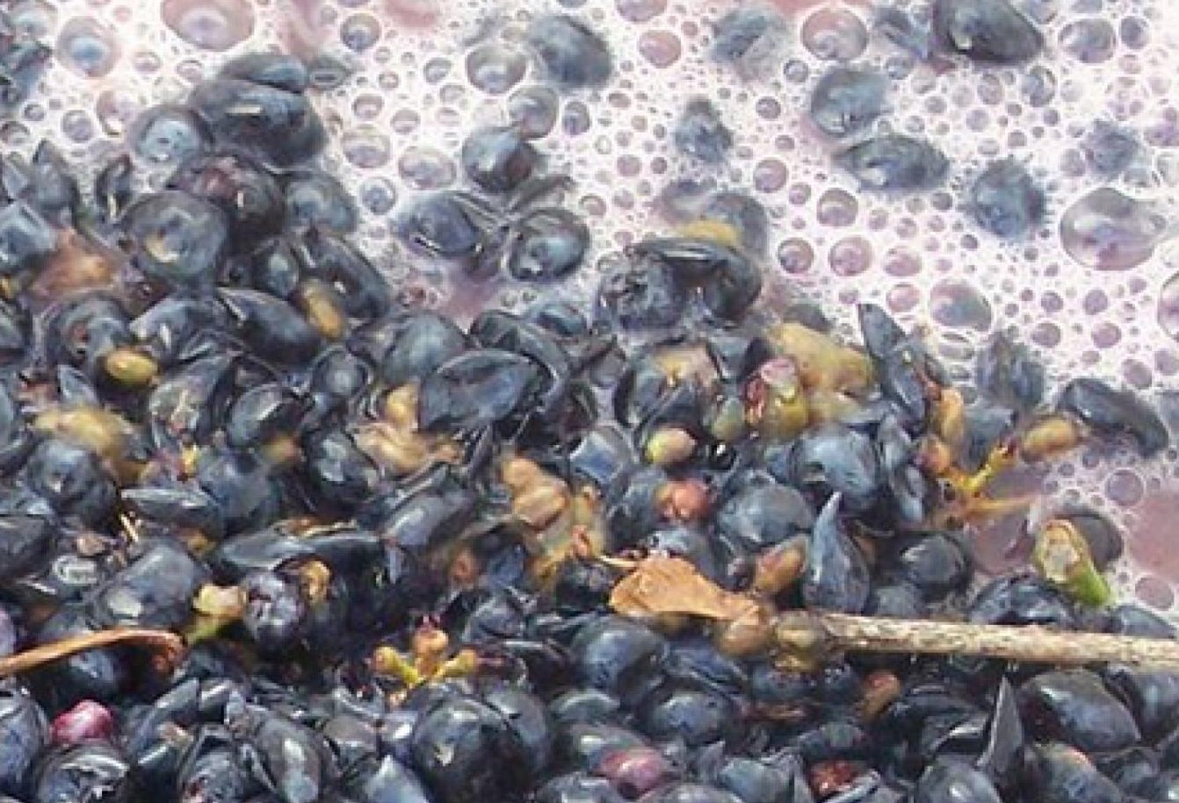
Notes:
There are single varietal expressions of Cabernet that count among South Africa’s very best wines but it is also frequently blended with Merlot and the other traditional Bordeaux varieties, Cabernet Franc, Petit Verdot and Malbec, according to the well-established template of that region (or with Shiraz according to the Australian model).

Slide 11
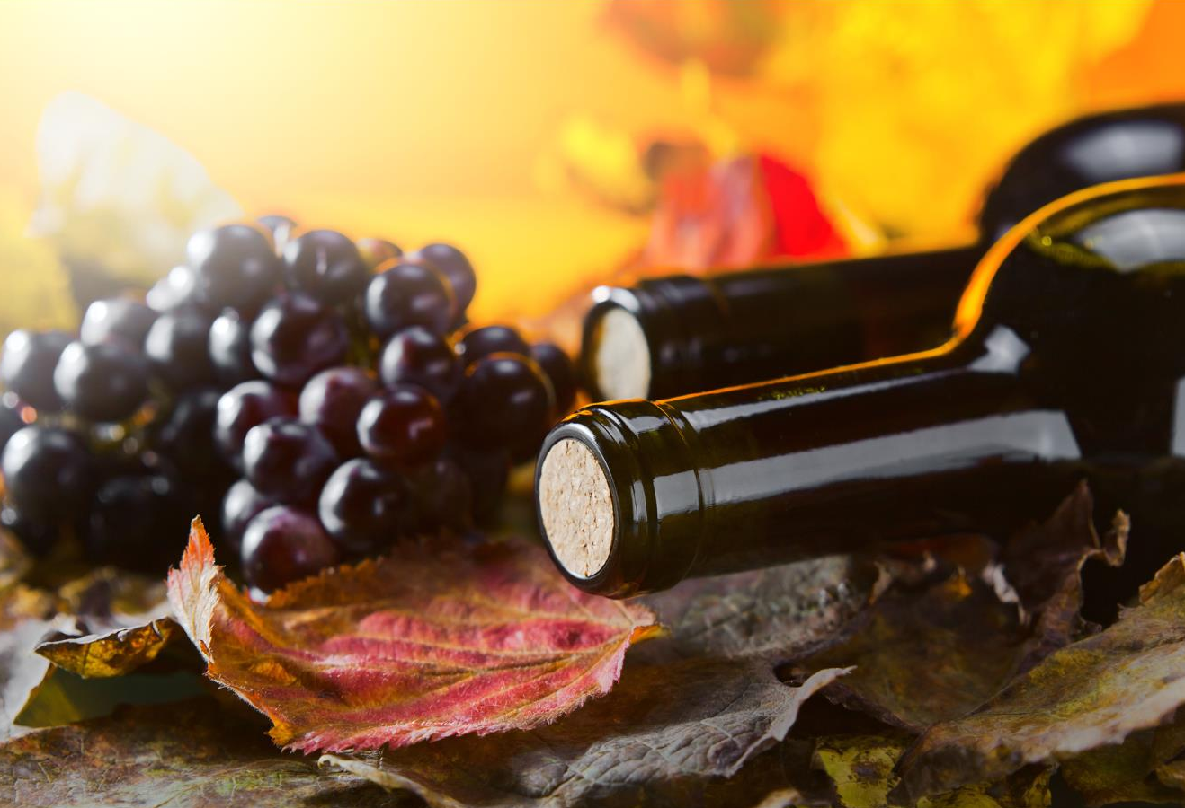
Notes:
South African producers are adept at achieving balance in their wines and there is plenty of pure, clean fruit on display.

Slide 12
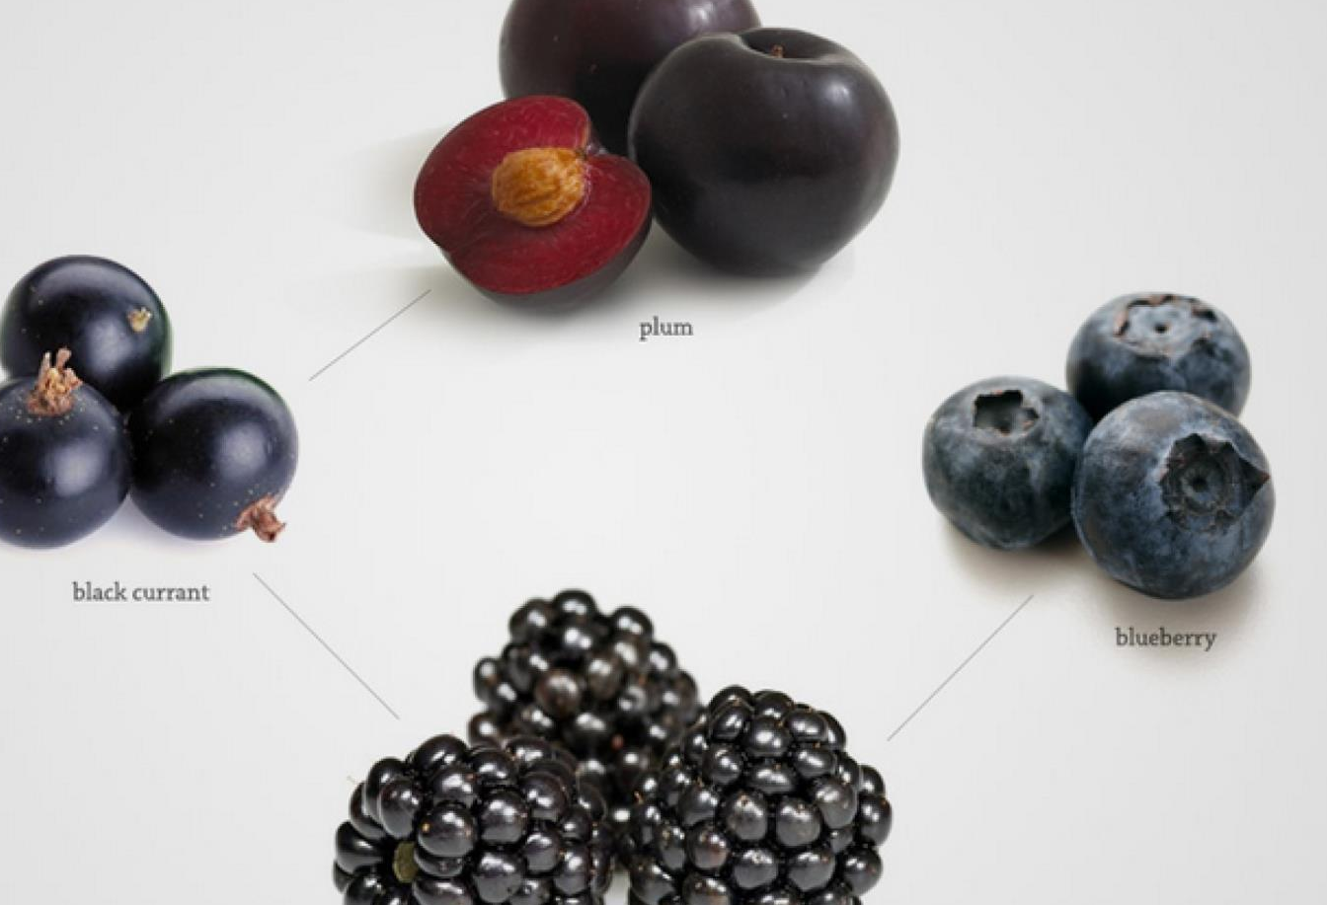
Notes:
Rich, smooth and complex, Cabernet’s flavour profile encompasses black cherry, blackcurrant, blackberry and ripe plum, with nuances that can include cassis, cedar, black pepper, tobacco, liquorice, vanilla or violet, and spiciness from the oak.

Slide 13
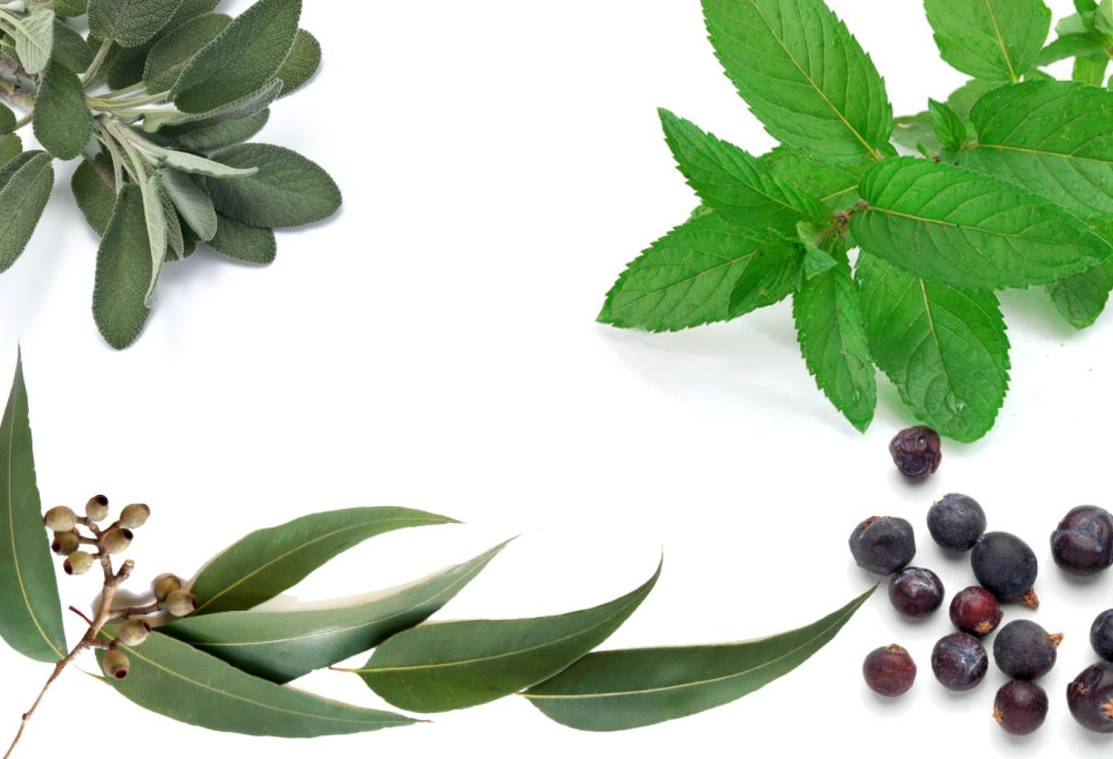
Notes:
In South Africa, an extensive range of clones produces a broad range of characteristics such as berry, eucalyptus and even mint from newer clones. Wines from older clones may be more herbaceous in character.

Slide 14
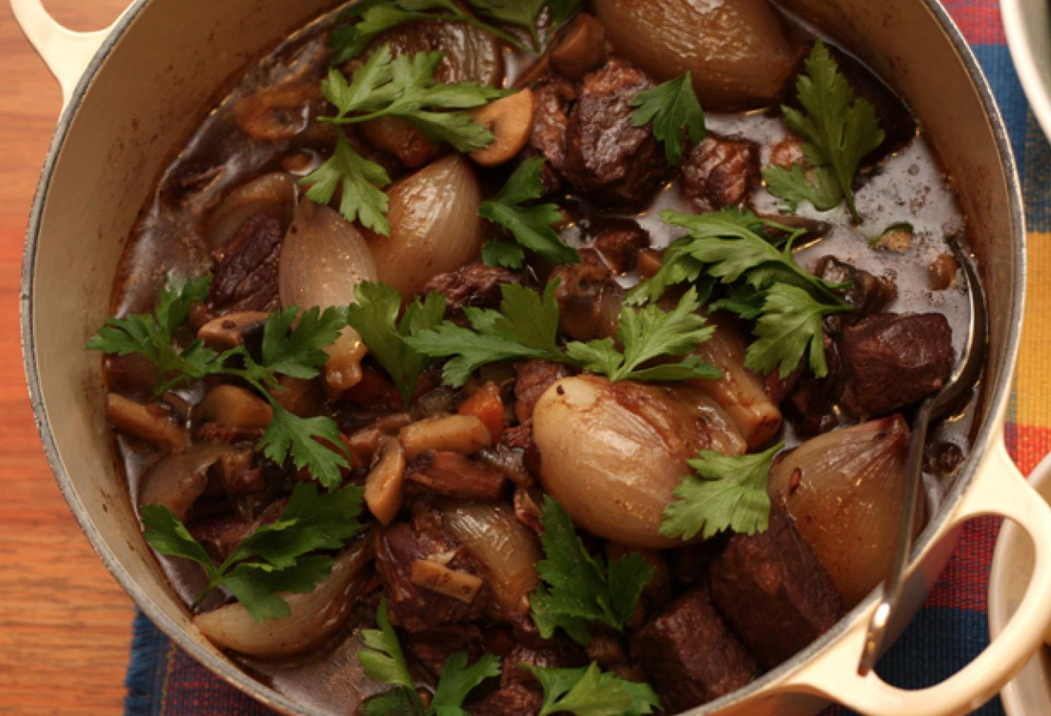
Notes:
Full-bodied Cabernet pairs well with meaty dishes, from roast beef or boeuf bourguignon to venison casseroles and oxtail stew.

Slide 15

“South African premium Cabernet
is characterised by richness and weight.
The very best examples have savoury complexity too.”
– Christian Eedes, wine writer

Slide 16
The end
Notes:
The end

